Slide 1
ARM Instruction Set

Slide 2
ARM Instruction Set
Instructions process data held in registers and access memory with load and store instructions.
Classification of instructions
Data processing instructions
Data Transfer Instructions - Load-Store instructions
Control flow instructions – Conditional & Branching instructions
S/W interrupt instructions
Program status register instructions

Slide 3
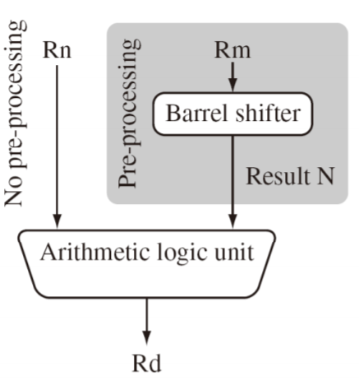
1. Data Processing Instructions
Perform arithmetic, logical, move, compare and multiply operations
All operations except multiply instructions are carried out in ALU
Uses 3- address instruction format:
Eg: ADD R0,R1,R2 ; R0 = R1+R2
All operands are 32 bits wide.
From register.
Specified as literals in instruction itself.
Result is 32 bits wide
Stored in register file.
Most Data Processing instructions can Pre-process one operand
using barrel shifter.
Eg: ADD R0,R1,R2, LSL #2 ; R2 = LSL by 2 position
; R0 = R1+R2

Slide 4
1. Data processing
Manipulate data within register
1.1 Arithmetic instructions
1.2 Logical instructions
1.3 Move instructions
1.4 Comparison instruction

Slide 5
1.1 Arithmetic Instructions
ADD add
ADC add with carry
SUB subtract
SBC subtract with carry
RSB reverse subtract
RSC reverse subtract with carry
ADD r0,r1,r2
ADC r0,r1,r2
SUB r0,r1,r2
SBC r0,r1,r2
RSB r0,r1,r2
RSC r0,r1,r2
Carry-in is the current value of C bit in CPSR

Slide 6
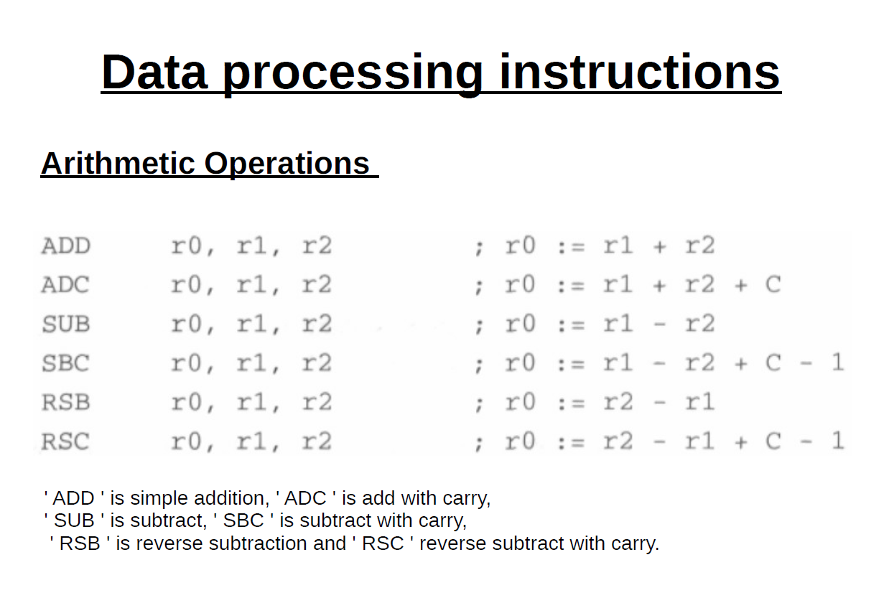

Slide 7
1.2 Bit-wise logical operations
AND r0,r1,r2
ORR r0,r1,r2
EOR r0,r1,r2
BIC r0,r1,r2
BIC
Bit Clear
Every ‘1’ in the second operand clears the corresponding bit in the first.

Slide 8
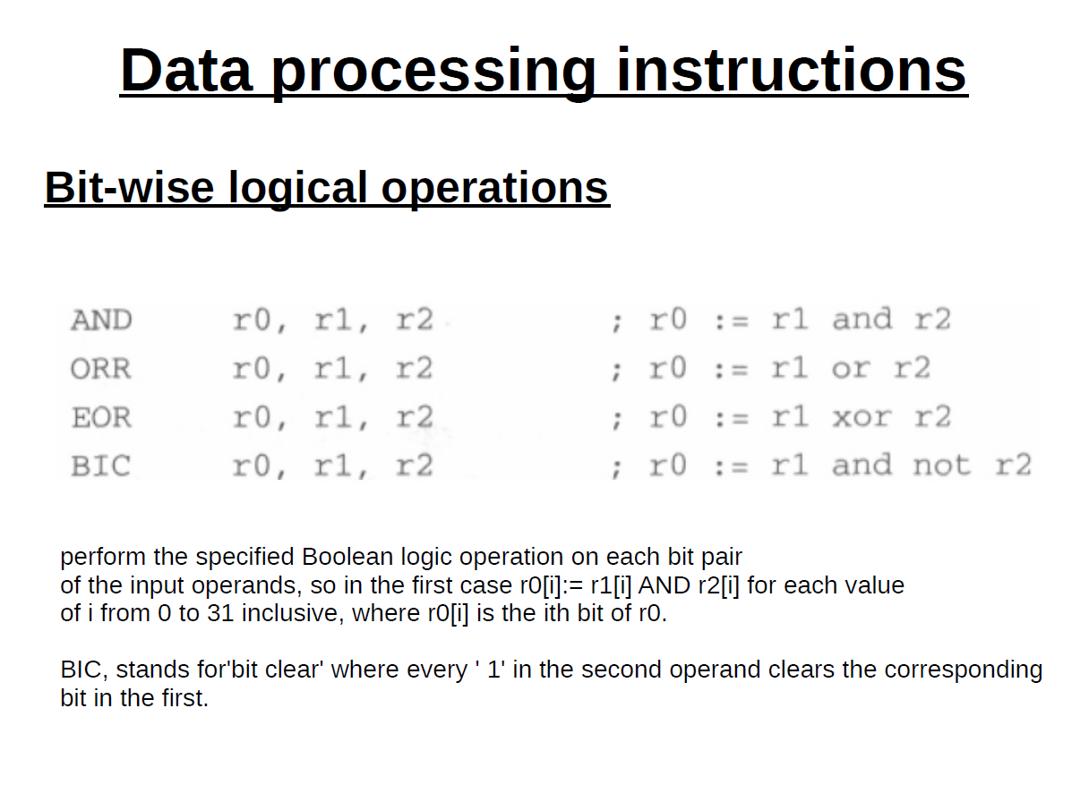

Slide 9
1.3 Register- Register movement operations
MOV Rd, N
Rd :destination register
N: can be an immediate value or source register
Example: MOV r7,r5
MVN Rd, N
Move into Rd negated value of the 32 bit value from source (N’).
Example: MVN r7,r5

Slide 10
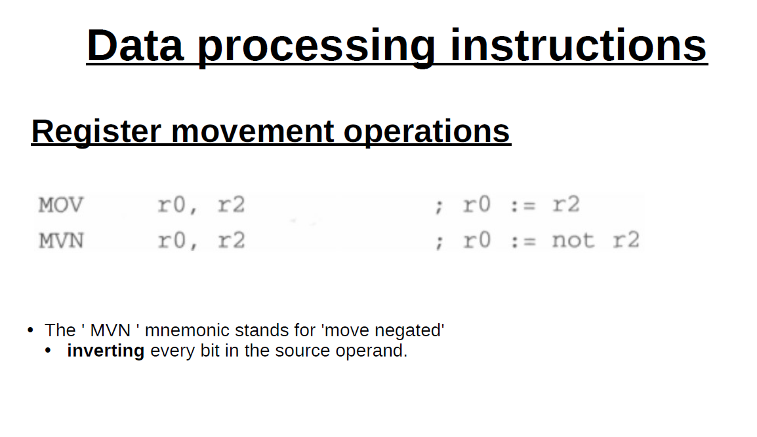

Slide 11
1.4 Comparison
Enables comparison of 32 bit values
Updates CPSR flags but do not affect other registers
CMP r1,r2 compare
CMN r1,r2 compare negated

Slide 12
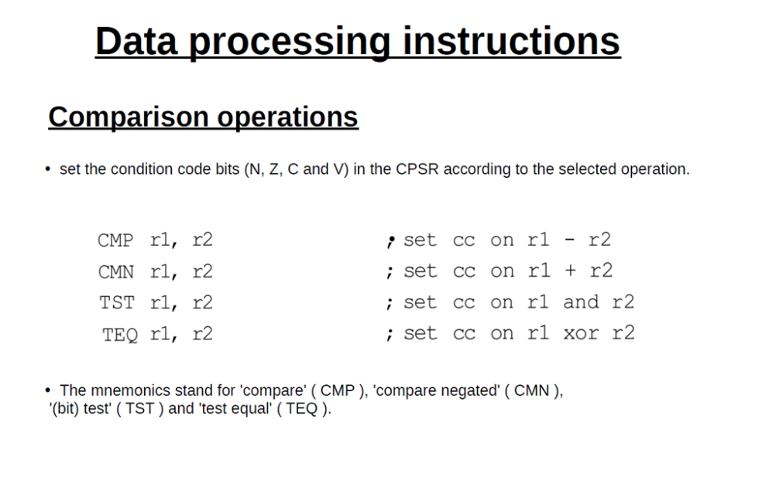

Slide 13
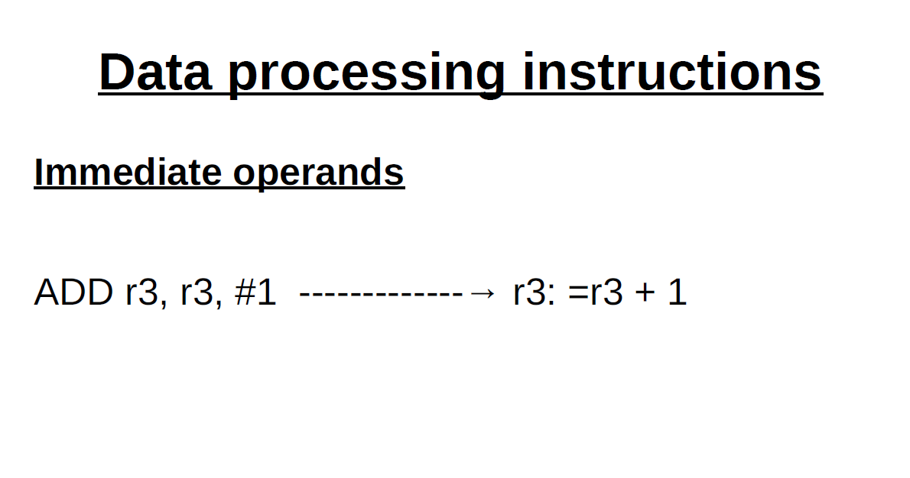

Slide 14
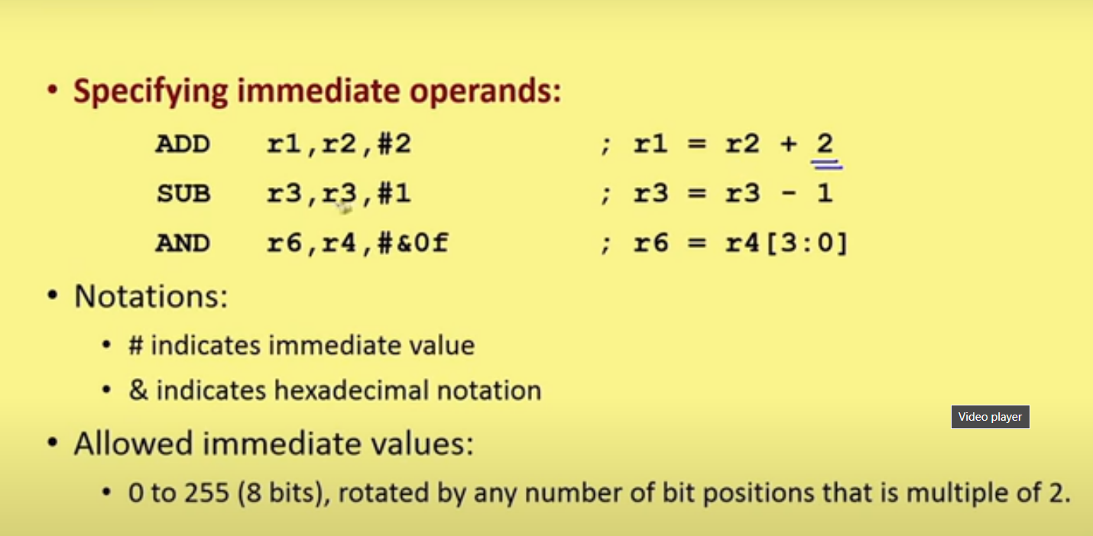

Slide 15
ADD r3,r2,r1, LSL #3
Shifted Register Operands
Single instruction.
Second reg operand subjected to shift.
LSL : Logical Shift Left.
Various shift & rotate operations:
Logical Shift Left (LSL),
Logical Shift Right (LSR),
Arithmetic Shift Left (ASL),
Arithmetic Shift Right (ASR),
Rotate Right (ROR),
Rotate Right Extended (RRX)

Slide 16
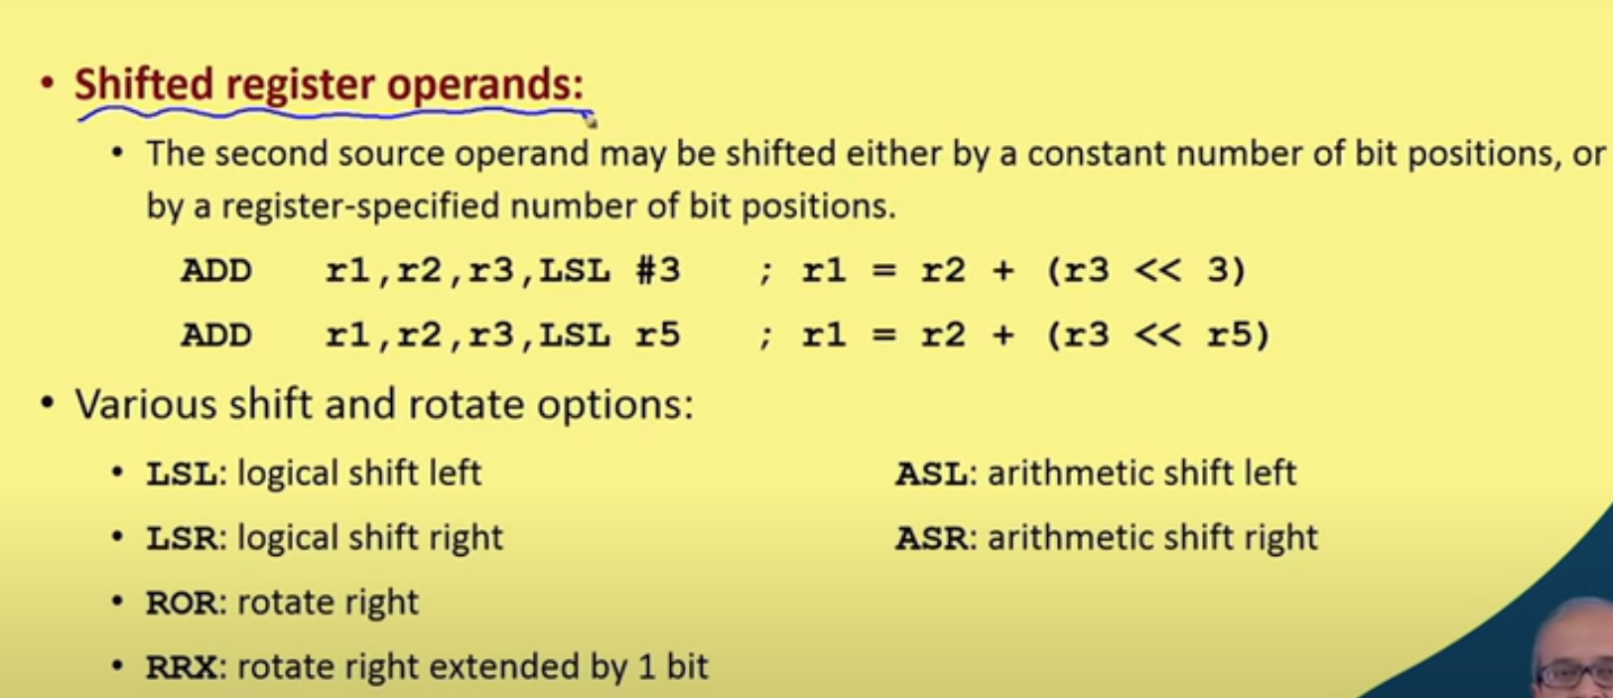

Slide 17
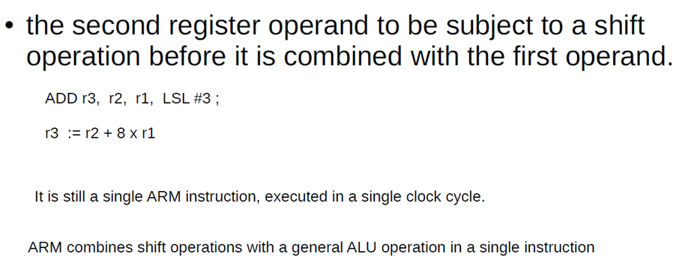
With Barrel shifter
Use of Barrel shifter with arithmetic and logical instructions increases the set of possible available operations.
Useful for fast multiplication and dealing with lists, table and other complex data structure.

Slide 18
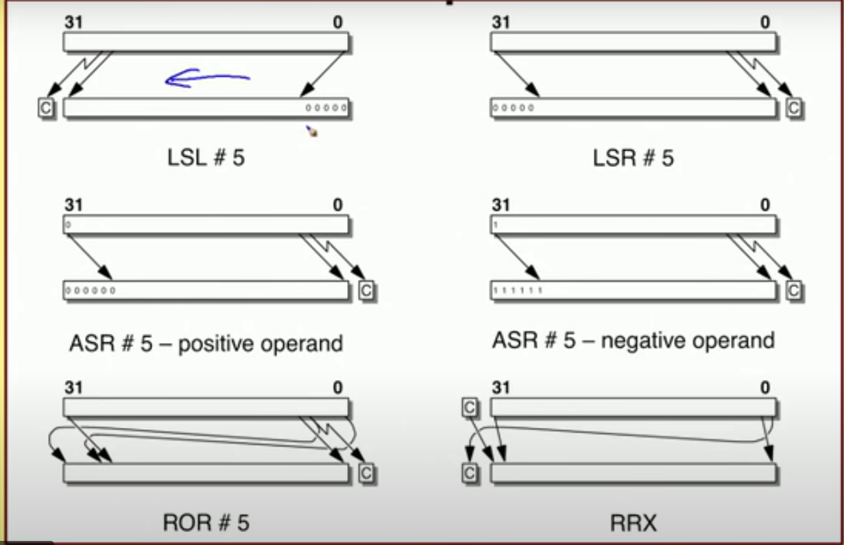

Slide 19
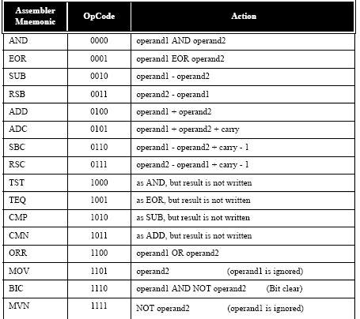

Slide 20
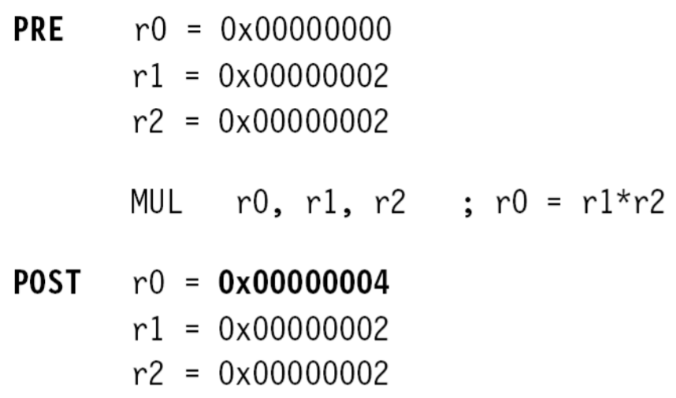
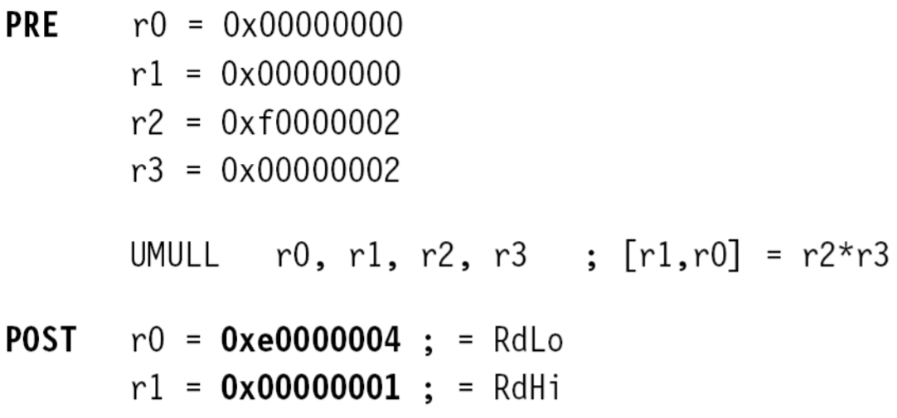
Multiply instructions
Multiply contents of a pair of registers
Multiplication by immediate constants not supported.
- long multiply generates 64 bit result
Examples:
→ mul r0,r1,r2
Contents of r1 and r2 multiplied and the result is put in r0.
→umull r0,r1,r2,r3 ; unsigned multiply long
Unsigned multiplication with result stored in r0 and r1.
Number of cycles taken for execution of multiplication instruction depends upon processor implementation.

Slide 21
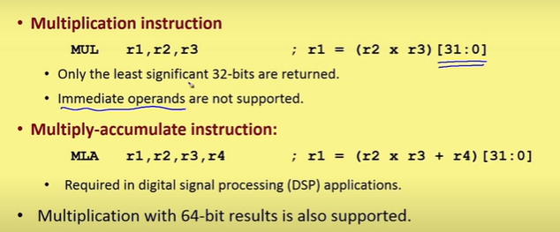

Slide 22
Multiply and Accumulate
Result of multiplication can be accumulated with content of another register
MLA Rd, Rn, Rm, Racc
Rd = (Rn*Rm)+Racc
UMLAL RdLo, RdHi, Rn, Rm
[RdHi,RdLo]=[RdHi,RdLo]+(Rn*Rm)

Slide 23
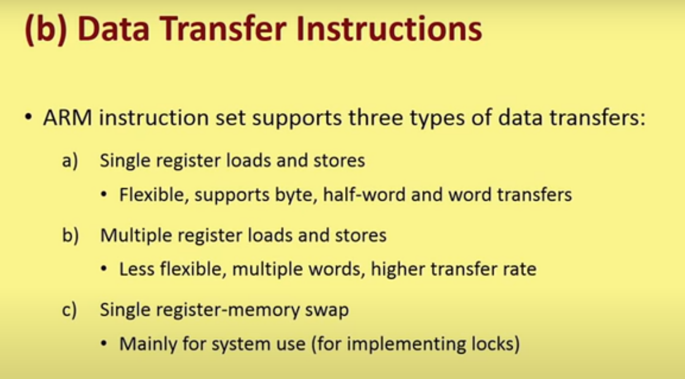

Slide 24
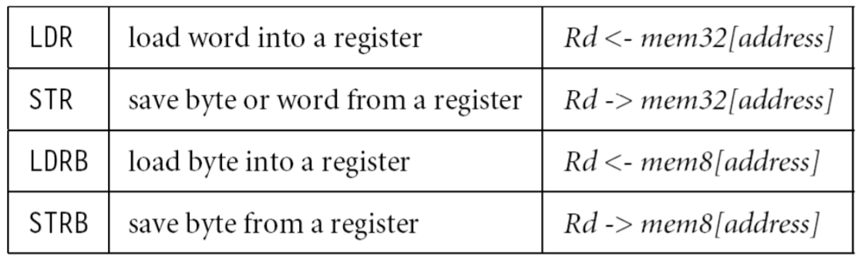
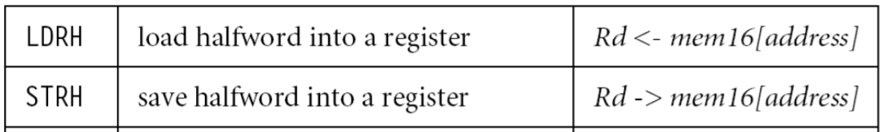
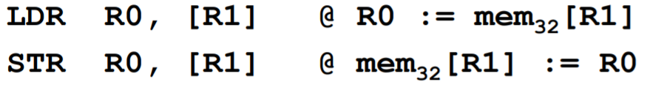
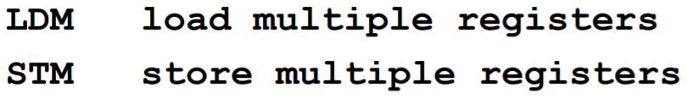
Data Transfer Instructions
Transfer data between memory and processor registers
Single register load/store
Data types supported are signed and unsigned words(32 bits), half word, bytes. Eg.
Multiple register load/store
Transfer multiple registers between memory and the processor in a single instruction
Swap
swaps content of a memory location with the contents of a register. For semaphore implementation. Eg. SWP (B)

Slide 25
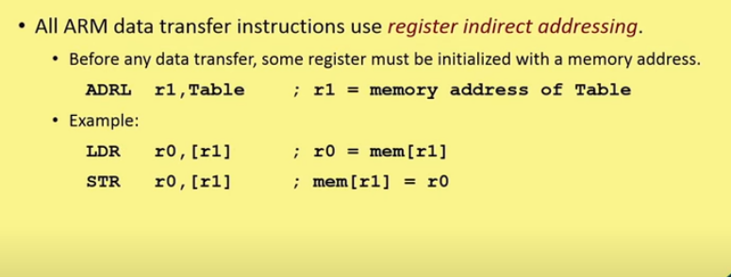

Slide 26
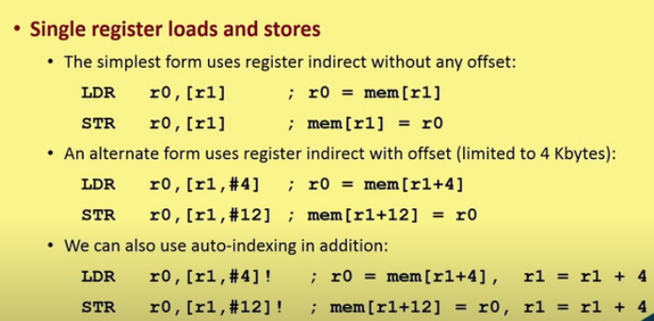

Slide 27
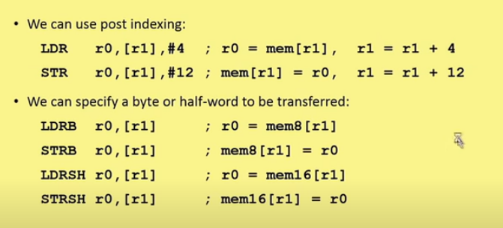

Slide 28
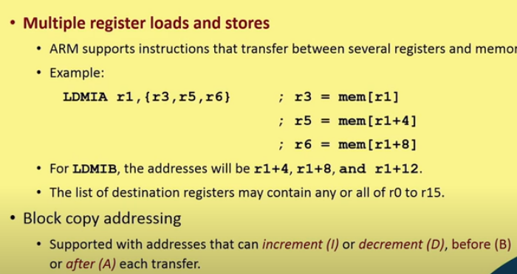

Slide 29
Stack Addressing
Stack:
last-in-first-out store
supports simple dynamic memory allocation [i.e., memory allocation where the address to be used to store a data value is not known at the time the program is compiled or assembled]
Implemented as a linear data structure which
grows up (an ascending stack) - memory as data is added to it and or
Grows down (a descending stack) - shrinks back as data is removed
Stack pointer holds the address of the current top of the stack, either by pointing to the last valid data item pushed onto the stack (a full stack), or by pointing to the vacant slot where the next data item will be placed (an empty stack).

Slide 30
ARM multiple register transfer instructions support all four forms of stack:
Full ascending: the stack grows up through increasing memory addresses and the base register points to the highest address containing a valid item.
Empty ascending: the stack grows up through increasing memory addresses and the base register points to the first empty location above the stack.
Full descending: the stack grows down through decreasing memory addresses and the base register points to the lowest address containing a valid item.
Empty descending: the stack grows down through decreasing memory addresses and the base register points to the first empty location below the stack.

Slide 31
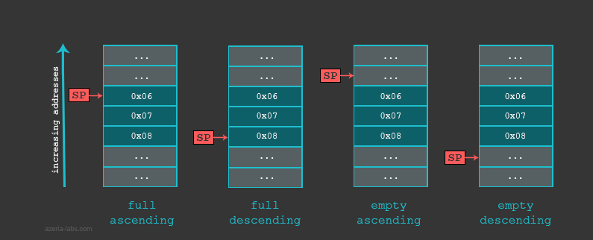

Slide 32
Block Copy Addressing
Copy a block of data from one place in memory to another place
Block copy view is based on whether the data is to be stored above or below the address held in the base register and whether the address incrementing or decrementing begins before or after storing the first value.

Slide 33
Block copy view-Multiple register transfer addressing mode

Slide 34
Block copy view-Multiple register transfer addressing mode

Slide 35
Mapping between the stack and block copy views of the load and store multiple instructions

Slide 36
Copy 8 words from location ro point to location r1 point
LDMIA r0!, {r2-r9}
STMIA r1, {r2-r9}

Slide 37
If r2 to r9 contains some useful information, it has to be pushed to stack
STMFD r13!, {r2-r9} ; save regs onto stack
LDMIA r0!, {r2-r9}
STMIA r1, {r2-r9}
LDMFD r13!, {r2-r9} ; restore from stack

Slide 38
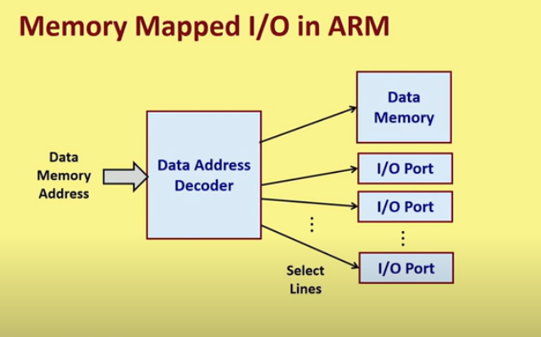

Slide 39
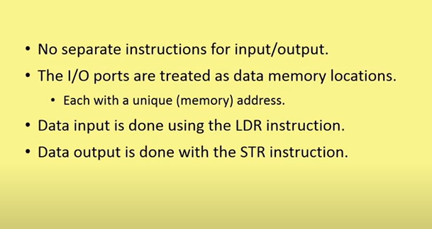

Slide 40

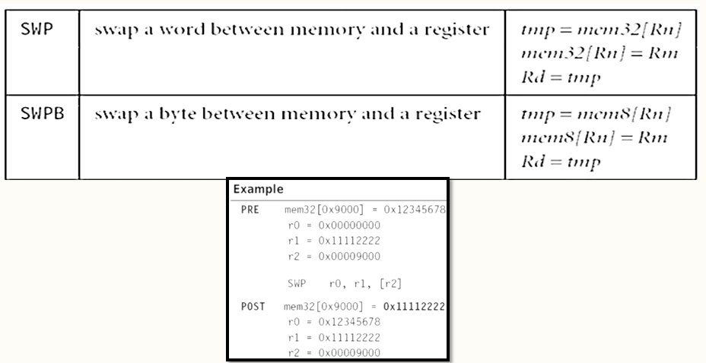
Swap between memory and register.
Syntax: SWP {B} {<cond>} Rd, Rm, [Rn]

Slide 41
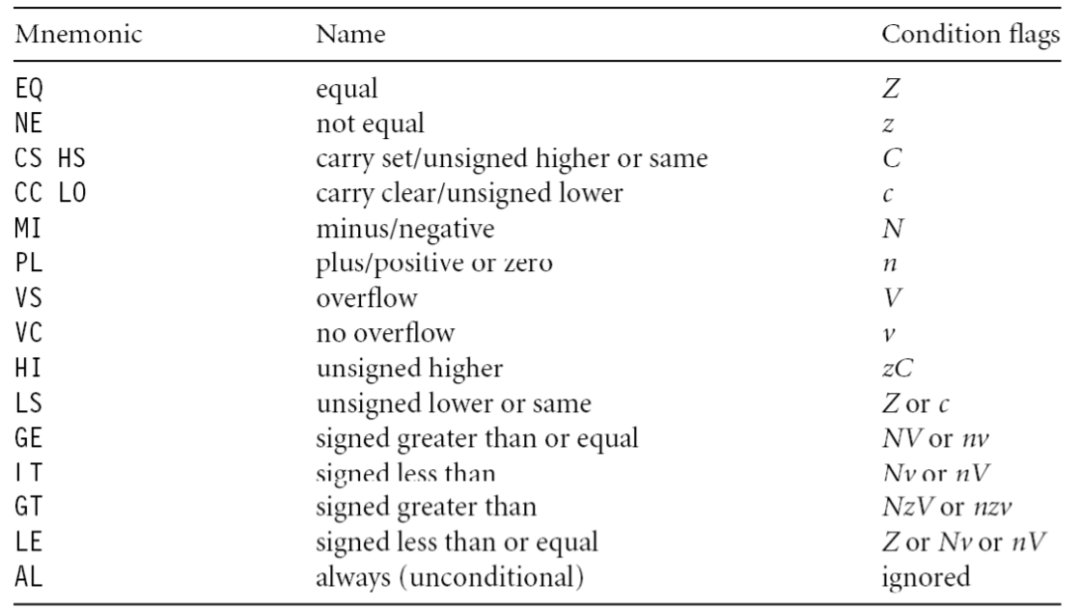
Control flow instructions
Determines which instructions next.
Branch
Branch Conditions

Slide 42
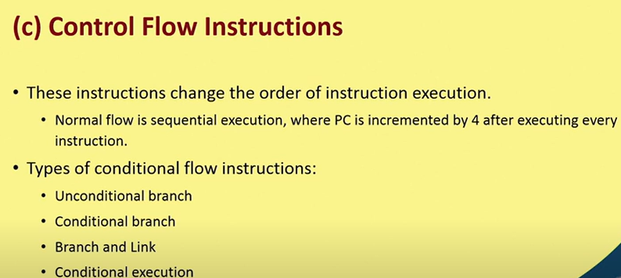

Slide 43
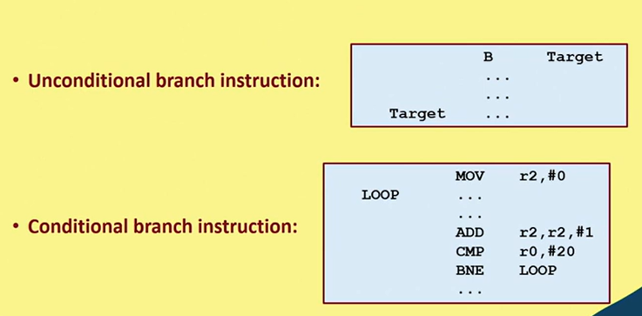
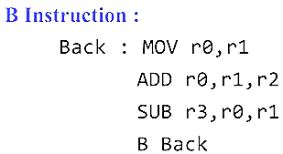

Slide 44
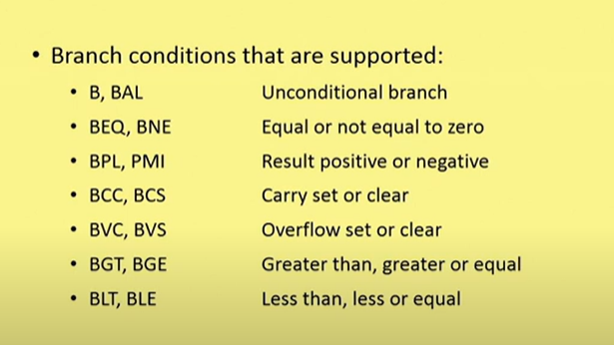

Slide 45
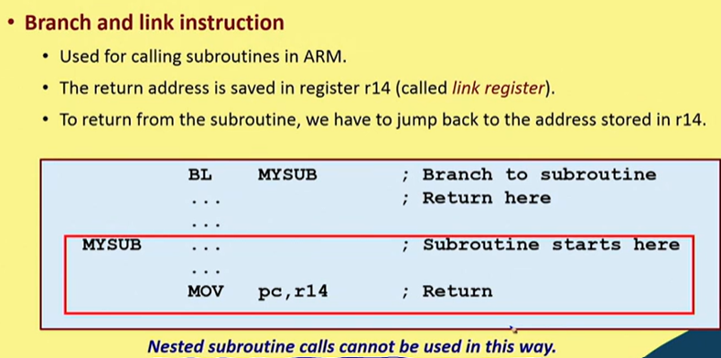
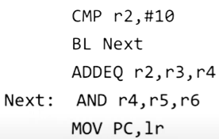
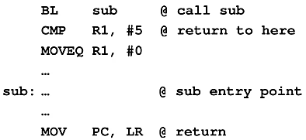

Slide 46
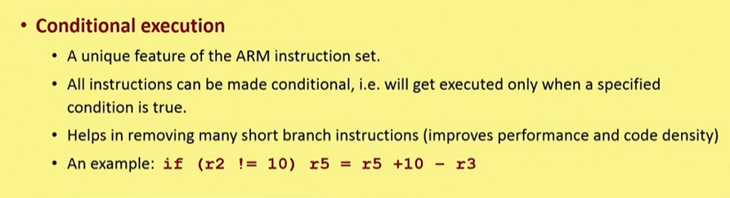
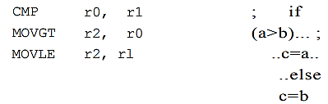
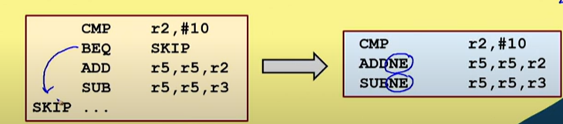

Slide 47
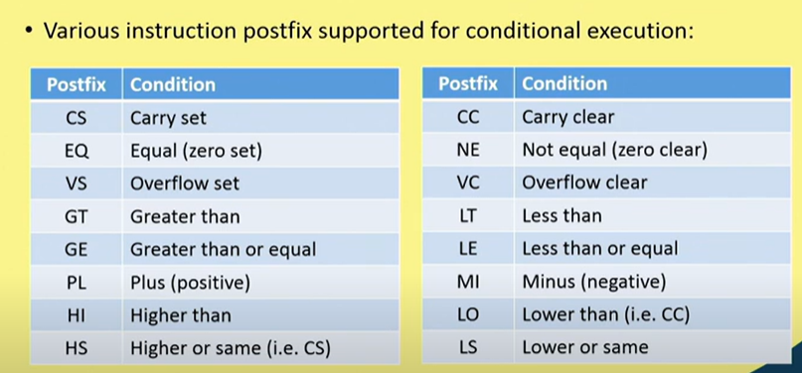

Slide 48

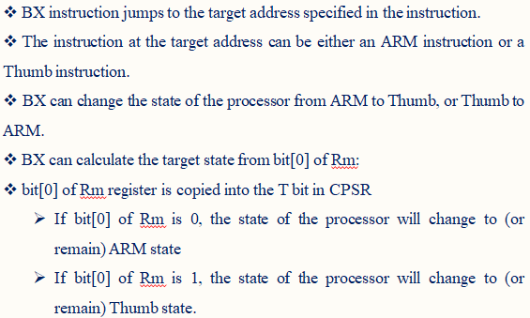
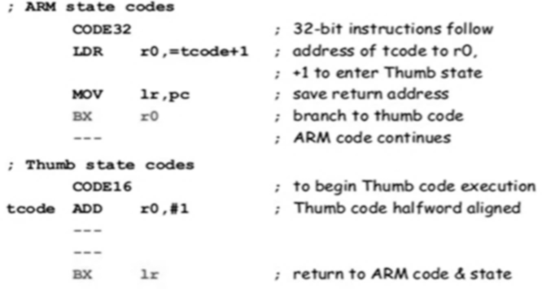

Slide 49
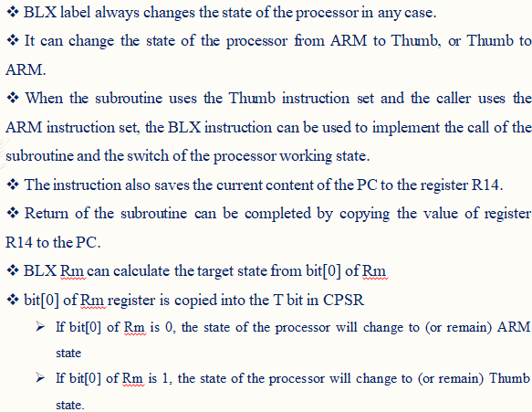
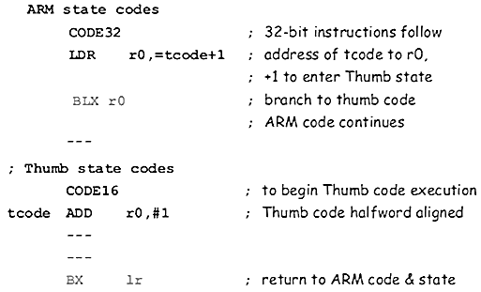

Slide 50
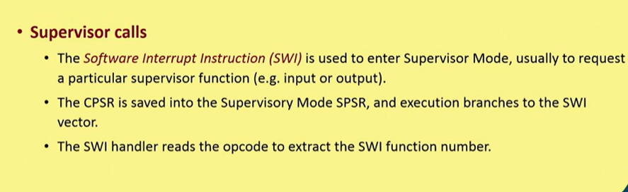
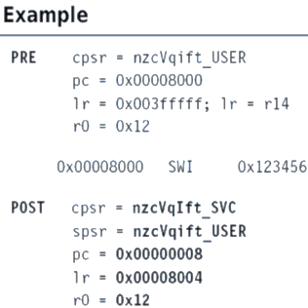
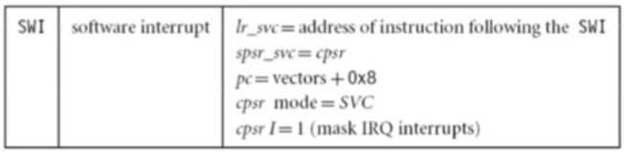

Slide 51
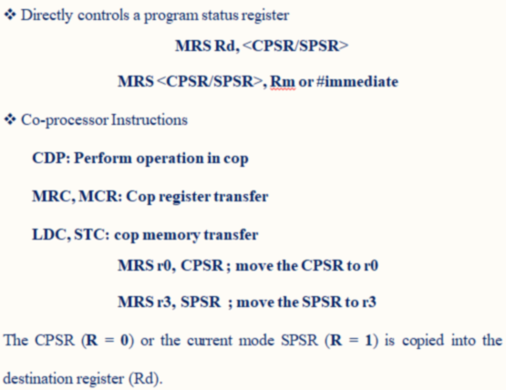
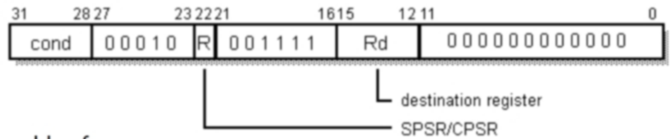

Slide 52
Thank You
References:
Text books: ARM System on Chip Architecture, 2nd edition,by Steve Furber ( Chapter 3 & 5)
https://youtu.be/UdY5RkkT7bg?list=PLbRMhDVUMngcJu5oUhgpgYqtOn7DmSfuU
https://youtu.be/yXSTWW0O1LE?list=PLbRMhDVUMngcJu5oUhgpgYqtOn7DmSfuU
https://youtu.be/xYQ60EqTNuo?list=PLbRMhDVUMngcJu5oUhgpgYqtOn7DmSfuU

